Slide 1
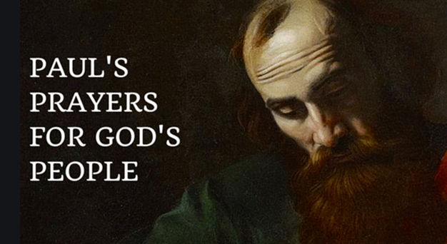

Slide 2
1 Thessalonians 5:23-24
May the God who gives us peace make you holy in every way and keep your whole being—spirit, soul, and body—free from every fault at the coming of our Lord Jesus Christ. He who calls you will do it, because he is faithful.

Slide 3
Romans 15:13
May the God of hope fill you with all joy and peace as you trust in him, so that you may overflow with hope by the power of the Holy Spirit.

Slide 4
Holy

Slide 5
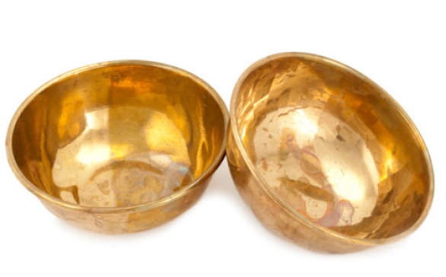

Slide 6


Slide 7


Slide 8
Wholly holy

Slide 9
soul
our thinking, our attitudes, our affections, our will,
our personality.
what makes you you.

Slide 10


Slide 11
2 Corinthians 7:1
Therefore, since we have these promises, dear friends, let us purify ourselves from everything that contaminates body and spirit, perfecting holiness out of reverence for God.

Slide 12
1 Thessalonians 4:13-18
Brothers and sisters, we do not want you to be uninformed about those who sleep in death, so that you do not grieve like the rest of mankind, who have no hope. For we believe that Jesus died and rose again, and so we believe that God will bring with Jesus those who have fallen asleep in him. According to the Lord’s word, we tell you that we who are still alive, who are left until the coming of the Lord, will certainly not precede those who have fallen asleep.

Slide 13
For the Lord himself will come down from heaven, with a loud command, with the voice of the archangel and with the trumpet call of God, and the dead in Christ will rise first. After that, we who are still alive and are left will be caught up together with them in the clouds to meet the Lord in the air. And so we will be with the Lord forever. Therefore encourage one another with these words.

Slide 14
Lets pray
May the God who gives us peace make us holy in every way and keep our whole being—spirit, soul, and body—free from every fault at the coming of our Lord Jesus Christ.
Amen.

