Slide 1
Life in all it fullness

Slide 2
John 10 v 7 -10
So Jesus said again, “I am telling you the truth, I am the gate for the sheep. All others who came before me were thieves and robbers, but the sheep did not listen to them. I am the gate. Whoever comes in by me will be saved, they will come in and go out and find pasture. The thief comes only in order to steal, kill and destroy. I come in order that you might have life - life in all its fullness”.

Slide 3
Philippians 4 v 19
“And my God will meet all your needs according to the riches of his glory in Christ Jesus”

Slide 4
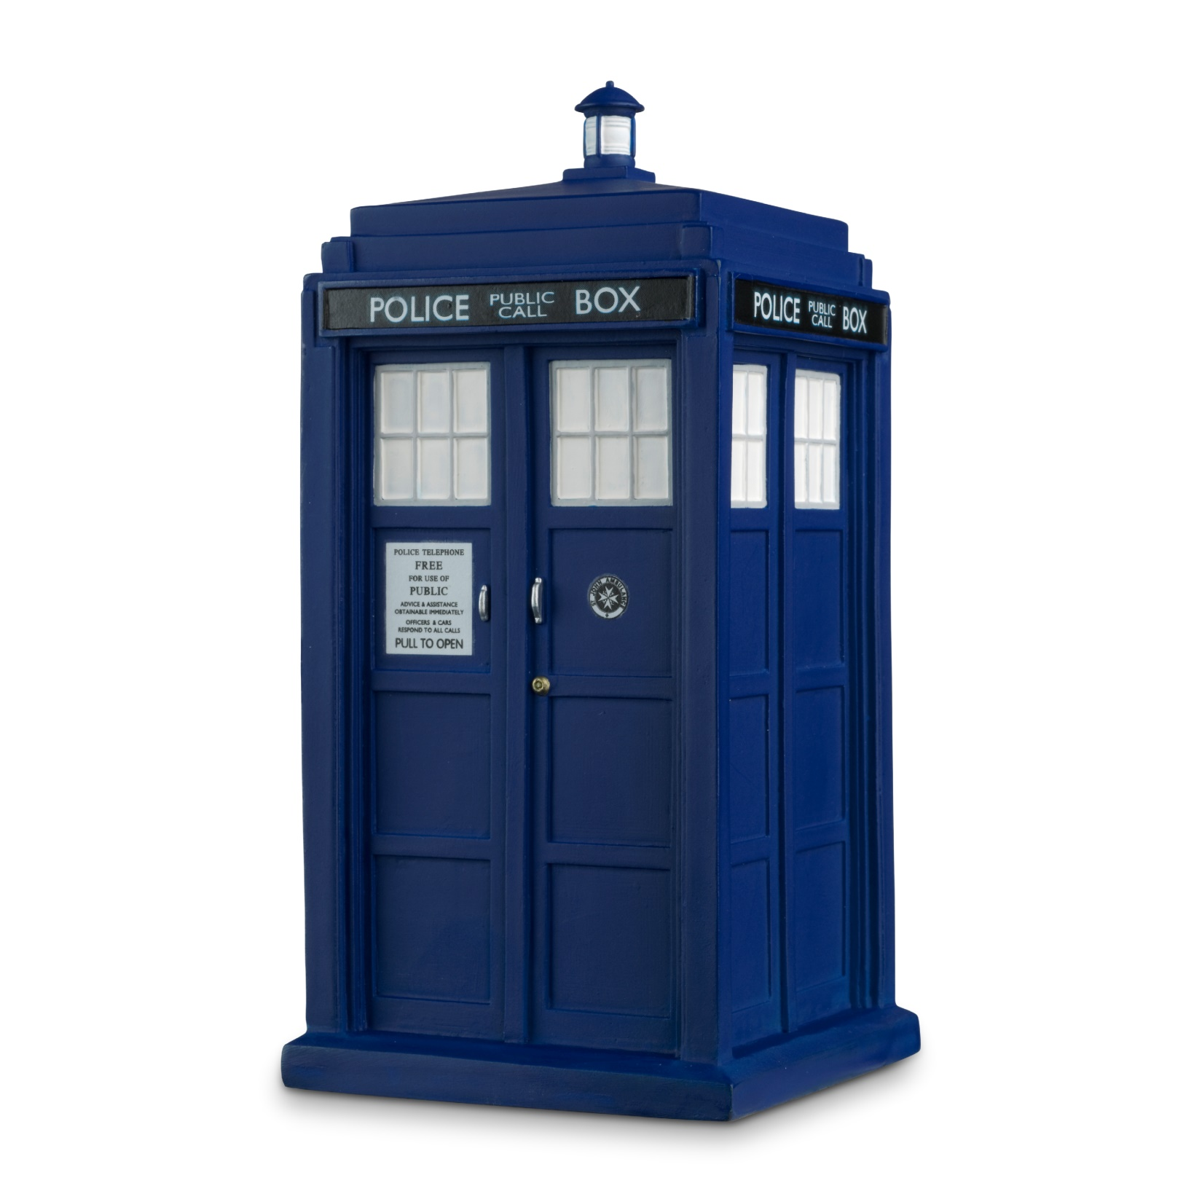

Slide 5
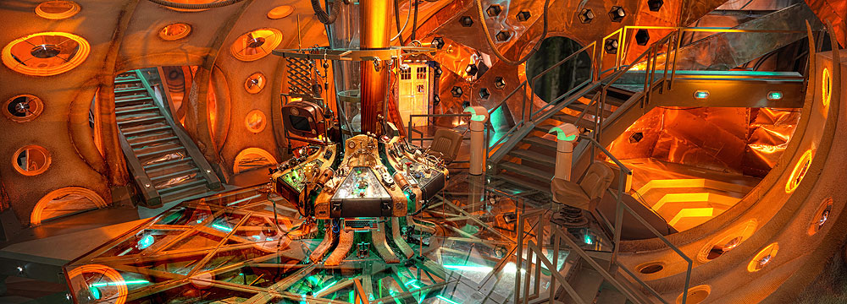

Slide 7
Psalm 18 v 19
“He brought me out into a spacious place, he rescued me because he delight in me”

Slide 8
John 3 – 16
“For God so loved the world that he gave us his one and only son that whoever believes in him shall not perish but have everlasting life”

Slide 9
Abundant Life

Slide 11
John 16 v 33
“I have told you these things so that in me you may have peace. In this world you will have trouble. But take heart! I have overcome the world”.

Slide 12
Mark 28 v 30-31
“Love the lord your God with all your heart and with all your soul and with all your mind and with all your strength. The second is this, love your neighbour as yourself, there is no greater command than these”.

Slide 13
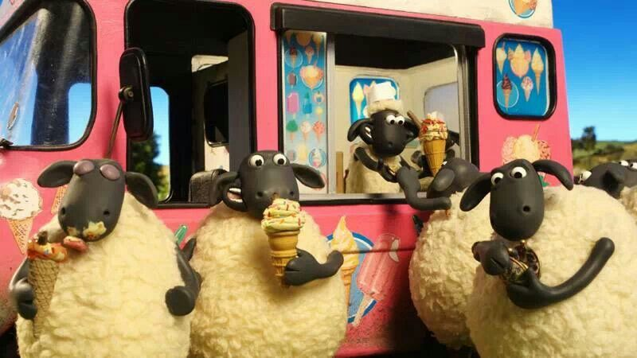

Slide 15
Romans 12 v 2
“Do not conform to the pattern of this world, but be transformed by the renewing of your mind”.

Slide 16
Deuteronomy 28 v 13
“The Lord will make you the head and not the tail. If you pay attention to the commands of the Lord your God”

Slide 17
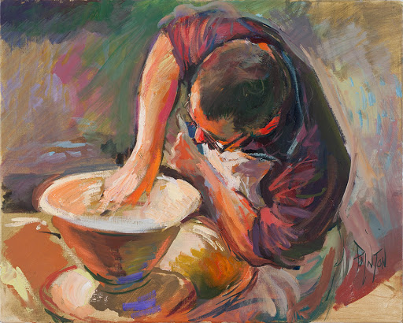

Slide 18
Isaiah 45 v3
“I will give you treasures hidden in the dark and secret places. Then you will know that I, the Lord God of Israel have called you by name”.

Slide 19
John 10 v 10
“He came that you might have life in all its abundance”.

